Slide 1

Clinical Appointment Prediction
Qingzhou Yao， Ph.D.

Slide 2
Business Purpose
Approach
Findings
Recommendation

Slide 3
Business Problems
Resource Management
Financial Impact
Patient Health
Operational Planning
Notes:
Large amount of patient miss their cilinical Appointments, which effect the hospital resource allocation and patient health condition.
Resource Management: Medical facilities need to allocate resources (staff, time, equipment) efficiently. No-shows lead to wasted resources and reduced efficiency.
Financial Impact: Missed appointments result in financial losses for healthcare providers due to unbilled time and resources.
Patient Health: Regular appointments are crucial for patient health management. No-shows can lead to deteriorating health conditions and higher long-term healthcare costs.
Operational Planning: Predicting no-shows allows better planning and management of appointments, potentially reducing waiting times for other patients.

Slide 4
Purpose
Build a machine learning model to predict the no-showing patients, give data insights and strategies to improve the patient showing up rate

Slide 5
Approach
Data preparation
Loading and preprocessing
Feature engineering
Graphing
Train_test_split
Model development
Logistic regression
Random forest
XGBoost
Hyperparameter tuning
Model Evaluation
Accuracy, precision, recall, f1, roc_auc

Slide 6

Findings
Data analysis
results from graphing
Best model and parameter
XGBoost
Model performance
Roc_auc score
Recall
Precision
Notes:
Recall (Sensitivity): The proportion of actual no-shows that were correctly identified by the model. High recall ensures that most of the no-shows are identified and thus, you can take action (e.g., sending reminders or follow-up messages) to mitigate them.
Precision: The proportion of predicted no-shows that are actually no-shows. High precision ensures that when you do take action, it is well-targeted, reducing unnecessary actions for clients who are not actually no-shows. Reduce the cost of miss calling the people who actually show up

Slide 7
Dataset
Size: 110527 rows, 14 columns
No duplicates and missing data
Columns
- countinuous features: Age
- binary features: Gender, MedicaidIND, Hypertension, Diabetes, Alcoholism, Disability, SMS_received
- categorical features: LocationID
- datetime features: ScheduledDay, AppointmentDay

Slide 8
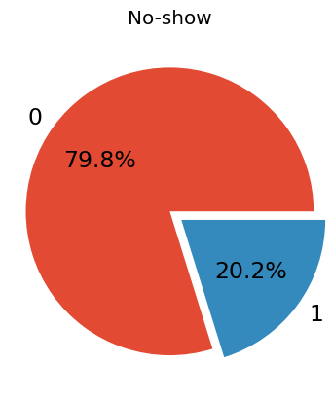
Targett
There are about 20% no-show appointment rate.
When we build the model, we need to pay attention to the imbalanced data.

Slide 9
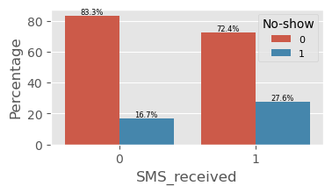
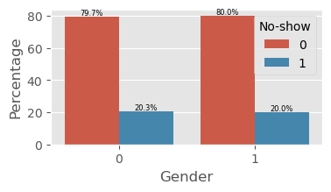
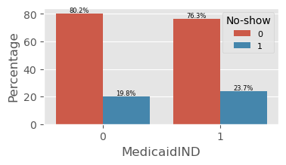
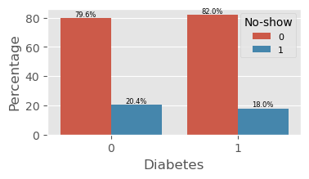
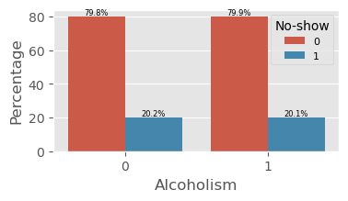
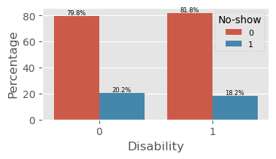
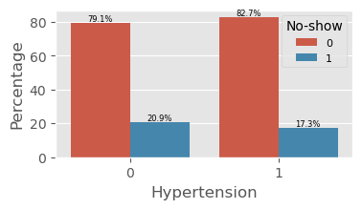
People receive SMS reminder, have higher rate missing their appointment

Slide 10
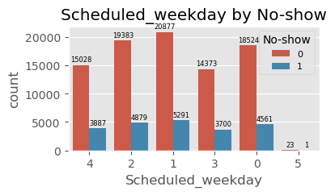
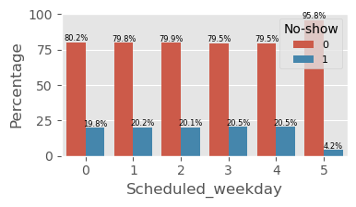
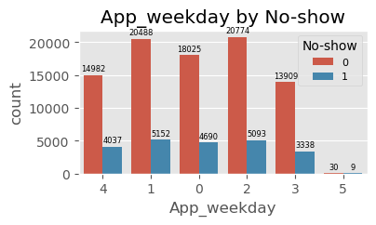
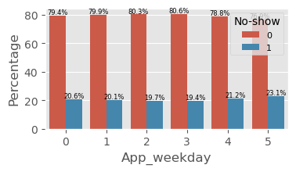
Scheduled and Appointment on Saturday is less
People show up rate is less on Saturday

Slide 11
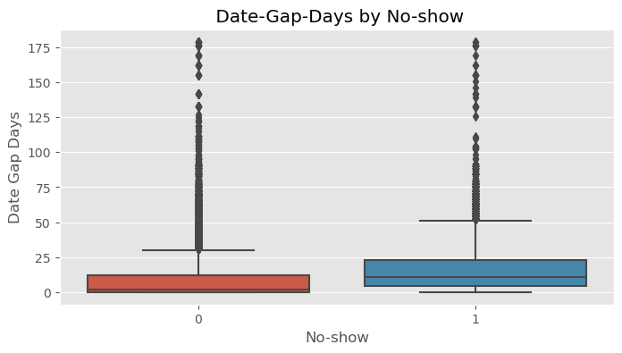
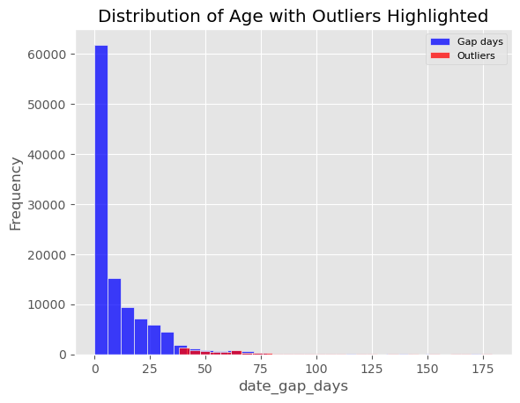
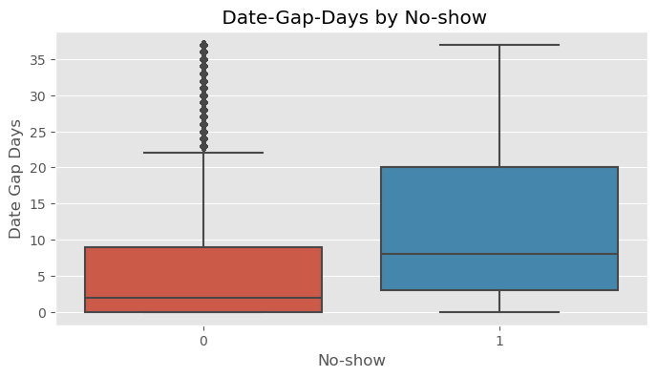
No-show | Count | Mean | STD | Min | 25% | 50 % | 75% | Max
0 | 84263.0 | 6.47 | 9.38 | 0 | 0 | 2 | 9 | 37
1 | 20456.0 | 12.19 | 10.50 | 0 | 3 | 8 | 20 | 37
- No-show group have higher mean value of gap date
- Longer gap date is easier to let people forget the appointment
- 2-3 days is the best

Slide 12
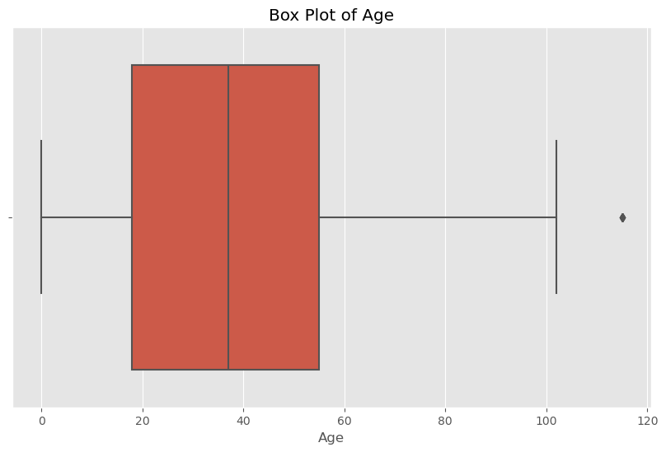
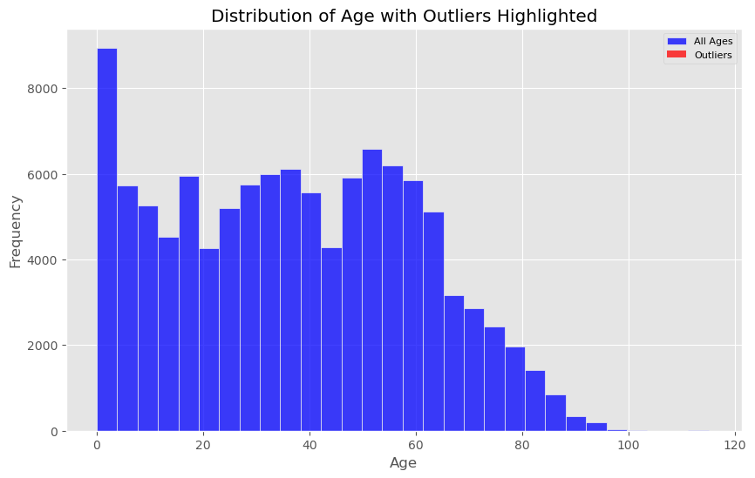
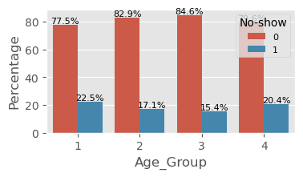
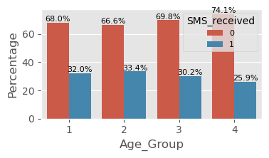
Age is likely a predictor for people missing their appointment

Slide 13
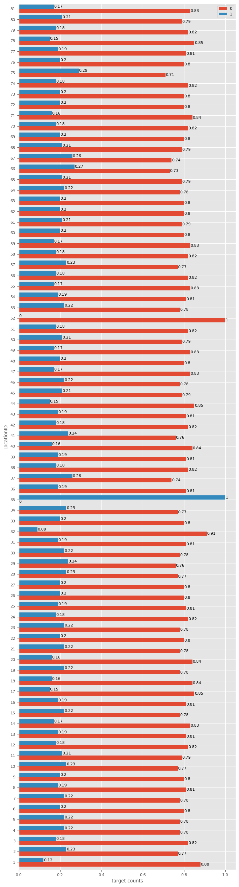
The ratio of Show to No-Show is almost the same for all LocationID.
There is not enough information about the LocationID, it might be the location of clinics that patients make the appointments.
Transportation, weather, the distances of patient home address to clinics could give more information to predict whether this patients show up to the appointments.

Slide 14
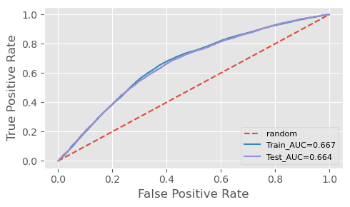
Logistic regression
train set accuracy: 0.669
train set precision: 0.754
train set recall: 0.669
train set f1 score: 0.697
training set AUC score: 0.667
test set accuracy: 0.664
test set precision: 0.750
test set recall: 0.664
test set f1 score: 0.692
test set AUC score: 0.664
Notes:
I first picked logistic regression, because we have a classification problem of binary target (yes and no for no show). So logistic regression is simple and fast and a basic model to start. After we evaluated the scores, we got accuracy of 66.4%, precision of 75%, recall 66.4%, f1 score 69.2%, and roc_auc score of 66.4% for testing, which is a little low. We also did hyperparameter tuning using GridSearchCV for different penalty (L1 and L2), C, and solver. However, the testing scores upon hyperparameter tuning did not improve. Therefore, we have decided to move on and explore other models.

Slide 15
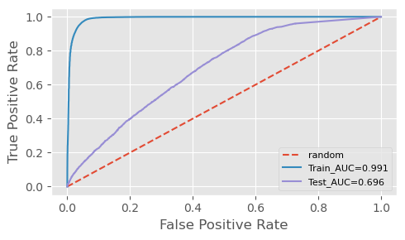
Random forest
Model performance for: Random Forest
train set accuracy: 0.979
train set precision: 0.980
train set recall: 0.979
train set f1 score: 0.979
training set AUC score: 0.997
test set accuracy: 0.773
test set precision: 0.732
test set recall: 0.773
test set f1 score: 0.745
test set AUC score: 0.709
Overfitting!

Slide 16
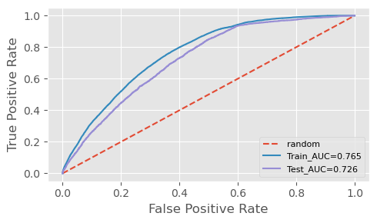
Random Forest Hyperparameter tuning
train set accuracy: 0.602
train set precision: 0.814
train set recall: 0.602
train set f1 score: 0.639
training set AUC score: 0.769
test set accuracy: 0.583
test set precision: 0.799
test set recall: 0.583
test set f1 score: 0.622
test set AUC score: 0.728
Notes:
I then picked random forest model. It is a more robust model BUT is can easily run into overfitting, because a single decision tree can overfit as it is easy to go too deep and to fit the parameters that are specific for that training set, rather than to generalize to the whole dataset. When more tree is added, it does not increase generalization. We did hyperparameter tuning using RandomizedSearchCV for n_estimators, max_depth, min_samples_split, min_sample_leaf, max_features, and bootstrap. A high recall score can be useful when the hospital’s main object is to reduce the overall no-show rate by identifying and engaging with as many potential no-shows as possible. In that case, we need to minimize false negative and ensure that the most actual no-shows are predicted. Even though the roc_auc score of 72.8% is not too bad and recall is high, the low accuracy score makes us decide that we should explore other models.

Slide 17
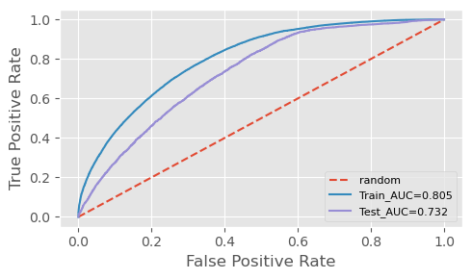
Model performance for XGBoost
train set accuracy: 0.814
train set precision: 0.809
train set recall: 0.814
train set f1 score: 0.754
training set AUC score: 0.805
test set accuracy: 0.798
test set precision: 0.746
test set recall: 0.798
test set f1 score: 0.732
test set AUC score: 0.732
Notes:
Finally, we chose XGBoost. XGBoost is a very powerful model. It develops one tree at a time, correcting faults caused by previously trained trees compared to random forest tree, which each tree is generated independently and the results are aggregated at the end. It also has higher accuracy and can handle large and unbalanced dataset like ours better. We also used DMatrix because it stores data in a compressed format and use parallel computing to decrease the runtime.
The scores for all metrics made us decide that XGBoost is the best model.

Slide 18

XGBoost Hyperparameter tuning
train set accuracy: 0.722
train set precision: 0.811
train set recall: 0.722
train set f1 score: 0.746
training set AUC score: 0.807
...
test set precision: 0.772
test set recall: 0.676
test set f1 score: 0.705
test set AUC score: 0.734
Notes:
We did hyperparameter tuning using RandomizedSearchCV for n_estimators, max_depth, min_samples_split, min_sample_leaf, max_features, and bootstrap. The testing scores for recall increased significantly from 20.6% to 83.3%, but accuracy decreased significantly from 77.3% to 58.4%. A high recall score can be useful when the hospital’s main object is to reduce the overall no-show rate by identifying and engaging with as many potential no-shows as possible. In that case, we need to minimize false negative and ensure that the most actual no-shows are predicted. Even though the roc_auc score of 72.8% is not too bad and recall is high, the low accuracy score makes us decide that we should explore other models.

Slide 19
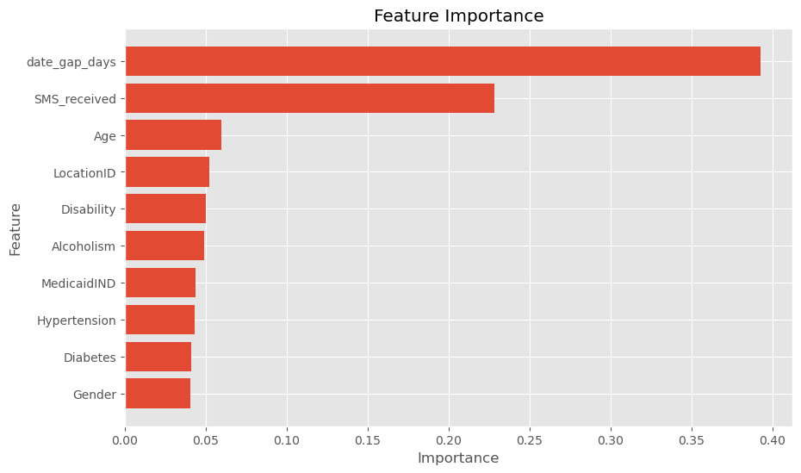
Feature Importance
Notes:
For XGBoost, we did a feature importance and saw that date_gap, SMS received, age, scheduled_weekday, MedicaidIND, gender have high feature importance whereas diabetes, hypertension, app_weekday, diasability, locationID, alcoholism have low feature importance. We could’ve excluded some of those features in the pipeline.

Slide 20
Recommendations
Future enhancements
Real life Operational improvement for hospital
Notes:
Recommendations
Real life Operational improvement for hospital
We know what are the features that have predicting power for no-shows, such as age, and gaps between scheduled appointment
Optimize scheduling practices (eg: overbooking in a controlled manner to account for expected no-shows, and identify patients that are high-risk for no-shows and provide additional support)
future enhancements
Explore additional features and external data sources (eg: weather conditions, transportation data) that could future improve the model’s predictive power
Drop features such as diabetes and hypertension that do not have high predicting power

Slide 21


Thank you!

